Slide 1
Ruby’s Boys
Love Truth & Reality Entertainment Group
INSPIRED BY A TRUE STORY…

Slide 2
TABLE OF CONTENTS
Topics for Discussion
The Story - 1
WGA Registration - 2
Location – 3
Target Audience - 4
Marketing Strategy - 5
Distribution Strategy - 6
Consultants - 7
Budget - 8
Contact Information - 9

Slide 3
THE STORY
Ruby Haynes a faith driven mother faced with the impossible challenge of raising 7 boys in the Chicago high rise Projects. With murder on the rise a Street Gang known as the Deadly Cobra’s Vs. The Almighty Vice Lords, erupted. Ruby up night after night walking and pacing from the sounds of gun fire. One of Ruby’s Boys is not only involve but a leader, Street name De’Marco her Second eldest son heads up the Almighty Vice Lords... De’Marco and his Mother often switch roles as the hero and villain concerning her other 6 Boys as they looked up to De’Marco, while Ruby prayed night and day hoping for a exit out of this Hostile environment, Her mission was to keep them alive while instilling bravery and wisdom into there very souls, The Peer pressure along with other known organizations were prevalent as a force to be reckoned with, namely, The Black P Stones Nation and Black Gangster Disciples Nation. Chicago gangland violence were at the peak of its time, 1960’s 70’s And 80’s. The goal for Ruby’s Boys were to keep them out of the Penitentiary and the Graveyard...
RABIA LOUIS HAYNES
1

Slide 4
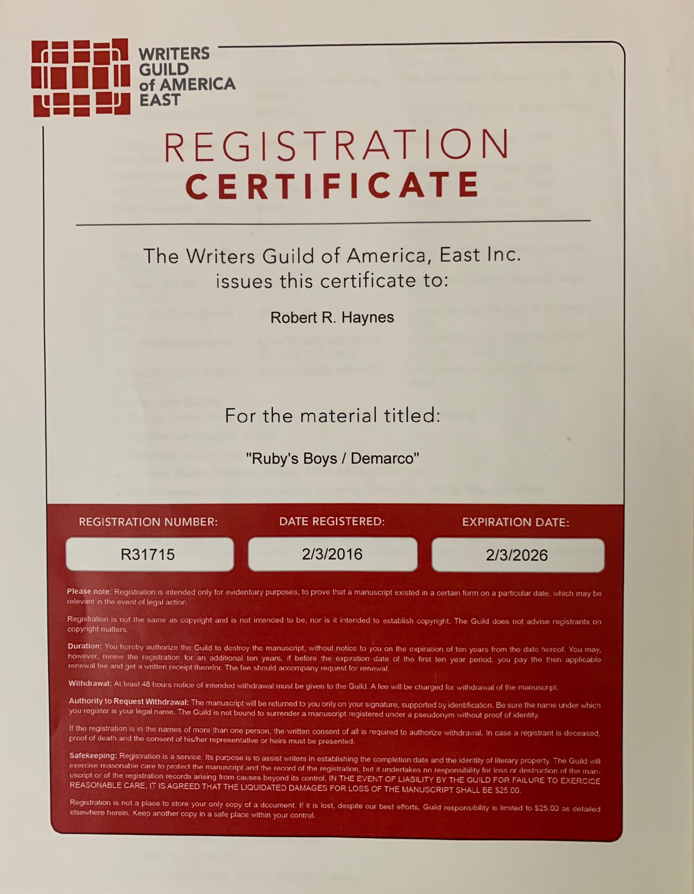
WGA REGISTRATION
2

Slide 5
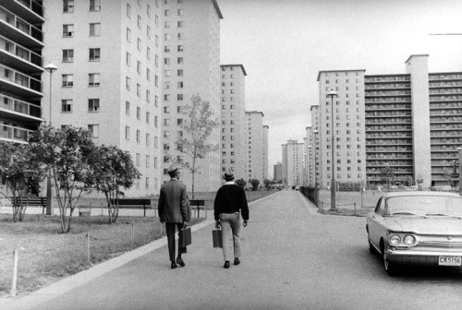
LOCATION
ROBERT TAYLOR HOUSING PROJECTS
CHICAGO, ILLINOIS
3

Slide 6
TARGET AUDIENCE
Teen Boys & Girls ages 15-19
Adult Men & Women ages 20-65
Cross the following Genres: Drama, Action, Family, Crime, and Comedy.
SMSA/MARKETS. AFRICAN AMERICAN POPULATION RANKINGS HISPANIC RANKINGS
New York… 3,000.000 Million # 1. Los Angeles 3,900.000 # 1
Chicago…. 2,100.000 Million # 2. New York 3,100.000 # 2
Los Angeles…. 1,900.000 Million # 3. Miami 2,500.000 # 3
Philadelphia… 1,500.000 Million # 4. Chicago. 1,500.000 # 4
Washington DC …. 1,400.000 Million # 5. Houston 1,100.000. # 5
Detroit… !,300.000 Million # 6. San Fran/Oak 900.000 # 6
Newark NJ…. 900.000 THOU # 7. San Antonio 700.000. # 7
Atlanta…. 900.000. THOU # 8. Dallas/FW. 700.000 # 8
Houston…. 800.000 THOU. # 9. San Diego. 600,000 # 9
Baltimore…. 700.000 THOU. # 10. ELPASO 550.000. #10
PROJECTED X 3 FOR MISCELLANEOUS MARKET
AFRICAN AMERICAN TOP 10 MARKETS TOTALS 14.5 MILLION. HISPANIC TOP 10 TOTALS 15.550… MILLION
4

Slide 7
MARKETING STRATEGY
THE BOOK *** THE PROMISED LAND ***
Great Black Migration How it changed America
Is a basic yet major premise to marketing this project, taking a family crime story from this source material however not based on the source material. Ruby’s Boys is a master piece taking from a family member (Rabia) and consultants based on real characters and personalities. While there is un-confirmed information in the book there is no false light to the story told from the families point of view… History should be told not sold with truth, truth is the head chemist of this books premise, not wavering or elusive…
In this age of Social Media Marketing it’s Axiomatic, that Facebook, Google ads, Twitter, Linkin, and many others methods and uses of marketing will benefit such a noteworthy project… Including old fashion reliable paid movie ads placements on TV, talk shows, day and night, Posters and Bill boards…
5

Slide 8
DISTRIBUTION STRATEGY
There is approximately 34 different foreign film markets and we here placing this at the head of the list to simply remind ourselves, when the domestic market is properly illustrated a vast of opportunity presents A, as you go strategy…
No.1… One way to distribute is through the major distribution packages sometimes with or without production funds depending upon what ratio of split and percentage the production company want to assume or consume.
No.2… Another route and strategy is to pay the fee’s and work with the 5 sub committee’s that divides U.S. market Into 5 territories and takes on no more than 20 films a year… These sub committee’s are independent distributors but not self distributors however operate like a major distributor that collects its fee’s first while the major’s collect the investments plus their interest first with a hold on production split for a longer period of time…
No.3… We have the option to self distribute however we would have limited release into theaters such as during mid January to end of April, and mid September to mid November releases only with the entire nut paid to theaters from our budget, however all pay out are deposited into production accounts…
6

Slide 9
CONSULTANTS
Rabia Louis Haynes served as unofficial apprentice for Steven Spielberg on the Movie Terminal Starring Tom Hanks.
2. Entertainment Attorney & Talent Manager Larry Thompson Organization.
3. Producer Director Bill Duke. 4. Leon Issac, Actor & Producer.
5. Music Consultant William Mickey Stevenson A&R Motown
{Cast Consultants} RUBY HAYNES DANIELS Kermit Campbell, Casey Madden, Larry Daniels, Mayo Bill Turner, Lawrence Robert Madden…
7

Slide 10
BUDGET
21,000,000. Million US Dollars
Story and other rights… $300,000
PRODUCERS… $1,000,000
DIRECTOR…. $800,000
PRINCIPAL CAST... $9,000,000
SUPPORTING CAST…. $ 3,000,000
STUNT... $ 1,500.000
Above the line travel & living $ 750,000 Totals $16,350,000
Below the line estimates.
PRODUCTION STAFF ALL INCLUSIVE TOTALS $4,650,000 = 21,000,000
A MORE PRECISE BREAKDOWN AND BUDGET IS FORTHCOMING PREDICATED UPON TALENT LETTERS OF INTENT AND ABOVE THE LINE NEGOTIATIONS……
8

Slide 11
CONTACT INFORMATION
RUBY’S BOYS
Screenplay
Writer & Producer
Rabia Louis Haynes
Email Address: amirrabia@gmail.com
PO Box 480572 Los Angeles 90048
310-864-4038
Karin Paparelli Attorney at Law Entertainment (615) 830-4124
9

